Slide 1

Course Introduction Computer Algorithms
Course Instructor:
Sumaiya Tasnim
Lecturer, Department of CSE
Varendra University

Slide 2
Overview:
Course Title: Computer Algorithms
Course Code: CSE 2203
Course Type: Theory
Credits: 3
Prerequisite Knowledge: Object Oriented Programming, Data Structure
Year and Semester: 2nd Year, Summer Semester

Slide 3
Instructor’s Detail:
Name: Sumaiya Tasnim
Designation: Lecturer
WhatsApp: 01799-011979
Web at Varendra University: https://vu.edu.bd/academics/departments/computer-science-and-engineering/faculty-members/02404/sumaiya-tasnim
Office Room: (Ground Floor, Academic Block)
Contact Email: sumaiya@vu.edu.bd
Older Power Point Slide’s Web Link: CSE_2203

Slide 4
Course Outcomes (COs), Program Outcomes (POs) and Assessment:
COs | Description | Taxonomy domain/level | POs | K | P | A
CO1 | Apply runtime analysis techniques | Cognitive/ Apply | PO-a | K2
CO2 | Design necessary algorithms to solve problems in real life. | Cognitive/ Creating | PO-c | K5
CO3 | Analyze the requirements for approximation of Complexity Classes. | Cognitive/ Analyze | PO-b | K4

Slide 5
Program Outcomes:
a) Apply knowledge of mathematics, natural science, engineering fundamentals and an engineering specialization as specified in K1 to K4 respectively to the solution of complex engineering problems.
b) Identify, formulate, research literature and analyze complex engineering problems reaching substantiated conclusions using first principles of mathematics, natural sciences and engineering sciences. (K1 to K4)
c) Design solutions for complex engineering problems and design systems, components or processes that meet specified needs with appropriate consideration for public health and safety, cultural, societal, and environmental considerations. (K5)

Slide 6
Knowledge Profile (K1–K8):
Code | Description
K1 | Mathematics, science, engineering fundamentals
K2 | Engineering specialization fundamentals
K3 | Advanced engineering knowledge
K4 | Research literature and methods
K5 | Engineering design
K6 | Engineering practices, tools, and resources
K7 | Effects of engineering on society and environment
K8 | Principles of project management and finance

Slide 7
Complex Engineering Problem Solving (P1–P7):
Code | Description
P1 | Depth of knowledge needed
P2 | Breadth of engineering disciplines involved
P3 | Familiarity with codes, standards, or specifications
P4 | Involve wide-ranging or conflicting technical and non-technical issues
P5 | Have no obvious solution and require original thinking
P6 | Involve multiple stakeholders and have significant consequences
P7 | Can be solved by structured approaches but involve uncertainty

Slide 8
Complex Engineering Activities (A1–A5):
Code | Description
A1 | Involve use of diverse resources (e.g., software, hardware, literature)
A2 | Require resolution of significant interactions within technical systems
A3 | Involve design and development under constraints
A4 | Require a wide range of tools and techniques
A5 | Involve multidisciplinary teams or interactions

Slide 9
Teaching-Learning Method:
COs | Teaching-Learning strategy | Assessment strategy
CO1 | Lectures, Power Point Slide, Book | Mid-Term exam
CO2 | Lectures, Power Point Slide, Book | Final Exam
CO3 | Lectures, Power Point Slide, Book | Presentation

Slide 10
Assessment Detail :
Assessment Tools |  | Marks (%)
Continuous Assessment (CA) | Class Participation | 10% | 40%
 | Class Test, Presentation | 30%
Summative Assessment (SA) | Mid-term Examination | 24% | 60%
 | Final Examination | 36%
Total |  | 100%

Slide 11
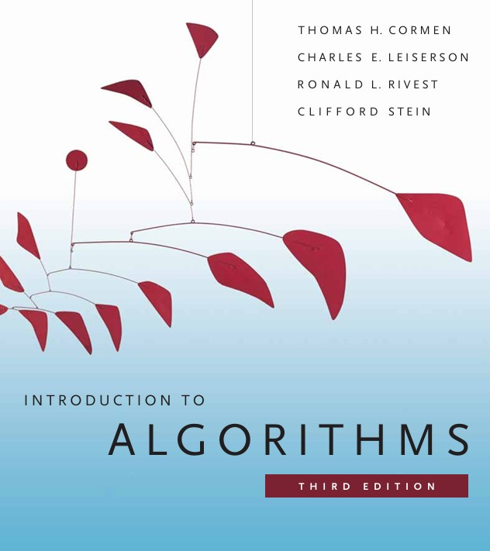
Textbook:

Slide 12


Reference Books:

Slide 13
Lecture Plan:
Sessions | Topics | Readings
Week-1 | Introduction and Basics of Algorithms, Searching Algorithms | PowerPoint slides & Text Book
Week-2 | Sorting Algorithms | PowerPoint slides & Text Book
Week-3 | Runtime Analysis Techniques | PowerPoint slides & Text Book
Week-4 | Runtime Analysis Techniques (Practice Problems), Divide & Conquer Algorithms | PowerPoint slides & Text Book
Week-5 | Divide & Conquer Algorithms | PowerPoint slides & Text Book
Week-6 | Greedy Design | PowerPoint slides & Text Book
Week-7 | Class Test and Review Class
Mid Term Examination

Slide 14
Lecture Plan:
Sessions | Topics | Readings
Week-8 | Greedy Design | PowerPoint slides & Text Book
Week-9 | Graph Theory | PowerPoint slides & Text Book
Week-10 | Graph Theory, Dynamic Programming | PowerPoint slides & Text Book
Week-11 | Dynamic Programming | PowerPoint slides & Text Book
Week-12 | Computational Complexity | PowerPoint slides & Text Book
Week-13 | Presentation
Week-14 | Class Test and Review Class
Final Examination

Slide 15
Course Conducting Policies

Slide 16
Missing Lectures
It is the student’s responsibility to gather information about the assignments and covered topics if he/she does miss the lecture.
The students must enter the classroom in time to get the attendance. No student will be allowed to enter the classroom after the attendance has been done.
No Late Entry
Attendance
Without 50% of attendance, sitting for final exam is NOT allowed.
Thyroid conditions:

Slide 17
Leaving Classroom
Once the attendance is done, a student can leave the class if he or she thinks that he or she is not getting benefits from the class.
Course Materials
The reading materials for each class will be available at Microsoft Teams (inside the Course Materials section of a Team dedicated to this course)
Schedule
The date and syllabus of quiz/class test will be announced in time in Microsoft Team
Thyroid conditions:

Slide 18
Leaving Classroom
Once the attendance is done, a student can leave the class if he or she thinks that he or she is not getting benefits from the class.
Course Materials
The reading materials for each class will be available at Microsoft Teams (inside the Course Materials section of a Team dedicated to this course)
Schedule
The date and syllabus of quiz/class test will be announced in time in Microsoft Team
Thyroid conditions:

Slide 19
Notification
Students will be notified in due time for class cancelation, extra class, make-up class and tutorial class.
Students are encouraged to participate in the class discussion and to ask questions. The student can ask any question without any hesitation as long as he or she can’t understand the topics being discussed; please keep in mind that if you don’t understand, it’s not your fault, it’s my limitation that I could not make you understand. The class is expected to be interactive.
Q/A
Presentation
Each student will have to present an oral presentation for 5 minutes on Computational Complexity related topics.
Thyroid conditions:

Slide 20
Knowledge Sharing
It is expected that the student will also provide some new knowledge related to the curriculum and then make the class as a place of knowledge sharing among all participants, both teacher and students.
Unfair Means
Any attempt for unfair means in the examination is strictly prohibited.

Slide 21
Ice-breaker Session

Slide 22
“ Students shouldn't go out into life without the ability to communicate.
Your success in life will be determined largely by:
- your ability to speak,
- your ability to write &
- the quality of your ideas,
in that order.“
— Late MIT Prof. Patrick Winston

